Slide 1
html tags
MCNDHS
Ms. Eng

Slide 2
aim: How do we create an upload form and a search form?
Do now:
Daily Grade:
On-time/attendance/not leaving the classroom: 25%
Cellphones: 25%
Notes:25%
Classwork/Homework: 25%

Slide 3
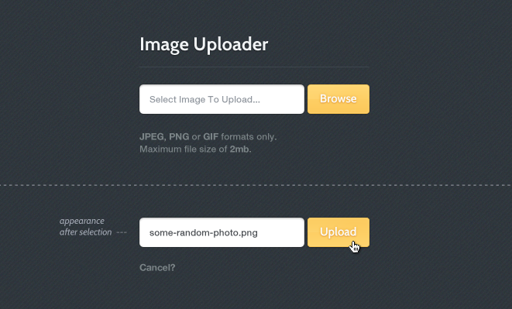
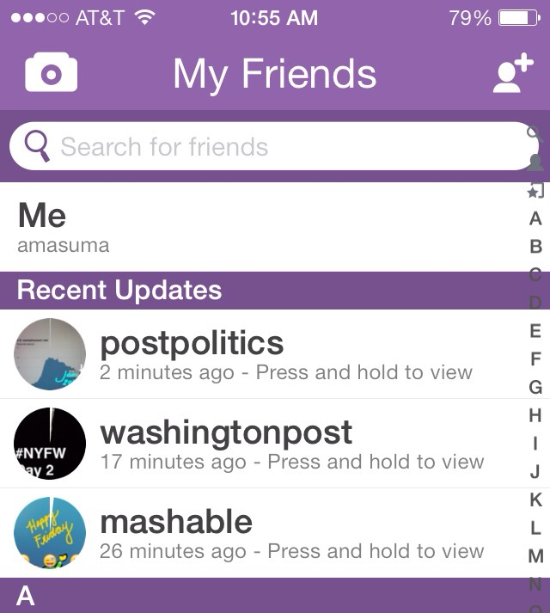
where you see it

Slide 4
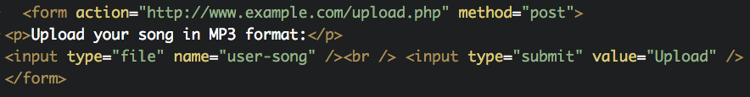
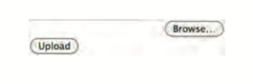
upload form
upload your song in MP3 format:

Slide 5
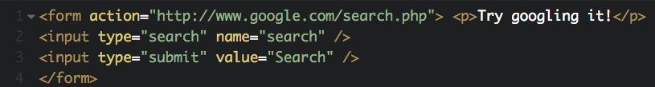
search form

Slide 6
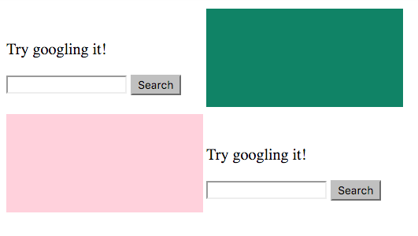
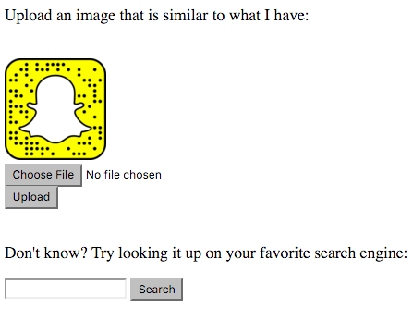
activity

